Slide 1



Slide 2
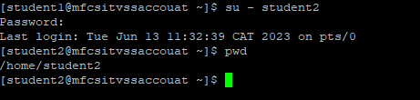
Linux project
Two users are created : student1,student2
Switch from student1 to student2

Slide 3
User accounts and their purposes
Root User: The administrator with full system privileges.
Regular Users: Individuals who have their own files, preferences, and limited system access.
User Groups: Users organized together for efficient permission management.
User Privileges: Different levels of access rights and permissions for each user.
User Authentication: Verification process for accessing the system.
User Management: Administrators handle account creation, deletion, and access control.
User accounts ensure security, privacy, resource isolation, personalized
experiences, and efficient management in a Linux environment.

Slide 4
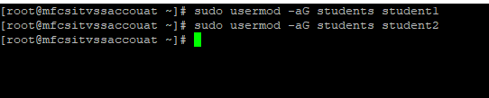
Adding users to the Group
Creating a group “Students”
Adding users student1,student2
Changing the ownership to group students
Add read and write permission to group students

Slide 5
File ownership, groups and permissions
File Ownership: Every file and directory in Linux is associated with an owner. The owner can be either a user account or a system process. The owner determines who has control over the file and can modify its permissions.
Groups: Groups in Linux allow users to be organized together for easier management of permissions. Each user can be a member of one or more groups. Group ownership of a file allows all members of that group to access and modify the file based on the group permissions.

Slide 6
Cont’d
Permissions: Linux uses a permission system to define who can read, write, or execute a file. Permissions are assigned to three categories: the owner of the file, the group associated with the file, and others (everyone else). Each category has three basic permissions: read (r), write (w), and execute (x). The permissions determine what actions can be performed on a file or directory.
File ownership, groups, and permissions are crucial for maintaining the security and integrity of a Linux system. They allow administrators to control access to files and directories, restrict modifications, and ensure proper collaboration among users and groups.

Slide 7
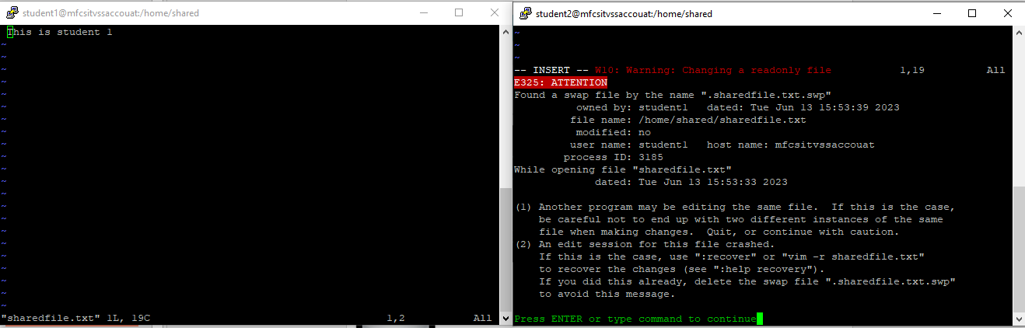
Editing the shared file at the same time
Student 1
Student 2

Slide 8
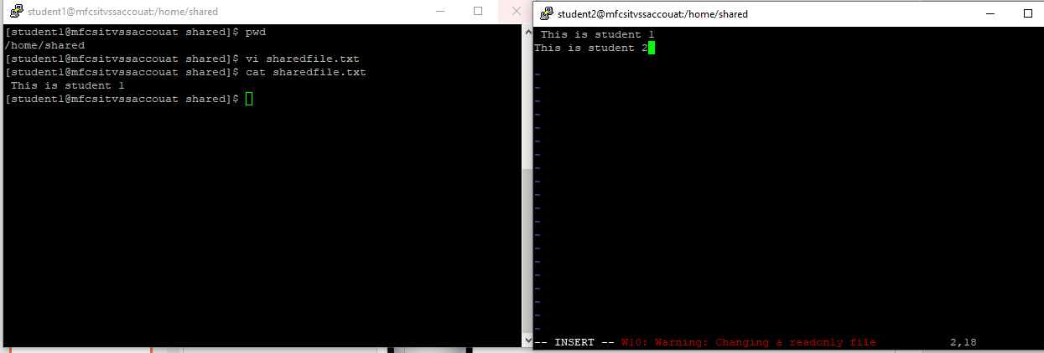
Cont’d
Student 2
Student 1
Student 1 user after saving changes, student 2 user can see them and edit the file

Slide 9
Text editor
A text editor is a software application used for creating, modifying, and saving text-based files. It provides a user-friendly interface for editing plain text files and offers various features to enhance productivity.
Linux offers a variety of text editors with different features and capabilities. Some popular text editors in Linux include Nano, Vim, Vi Emacs, and Gedit.
Overall, the basic functionality of a text editor in Linux involves opening a file, editing the text, saving changes, and exiting the editor, allowing users to manipulate plain text files efficiently in a Linux environment.

Slide 10
The importance of communication when working on shared files
Minimizing conflicts: Effective communication allows team members to discuss their work, intentions, and progress. It helps identify potential conflicts or overlapping efforts, enabling the team to resolve them before they become problematic.
Maintaining consistency : Communication ensures that team members adhere to agreed-upon formatting, styles, and guidelines. Consistency in shared files leads to a unified and professional outcome.
Problem-solving: Communication and coordination facilitate effective problem-solving. Team members can discuss challenges they encounter while working on shared files and collaboratively find solutions.

Slide 11



